Slide 1
Nonclassicality, quasiprobabilities and weak values explored in neutron interferometry
Ismaele Vincent Masiello
Neutron and Quantum Physics
Atominstitut
TU Wien, Austria

Slide 2
Motivation and goal
Quantum mechanics exhibits features with no classical counterpart.

Slide 3
Motivation and goal
Quantum mechanics exhibits features with no classical counterpart.
However, not all quantum experiments exhibit non-classical features and identifying the classical/quantum boundaries is of importance.

Slide 4
Motivation and goal
Quantum mechanics exhibits features with no classical counterpart.
However, not all quantum experiments exhibit non-classical features and identifying the classical/quantum boundaries is of importance.
We are interested in experimental tools to probe such boundaries.

Slide 5
Overview
Preparation-Measurement scenarios
Quasiprobability representations and weak values
Experimental results

Slide 6
Preparation-Measurement scenarios

Slide 7
Preparation-Measurement scenarios
Disclaimer: not all experiments are this simple

Slide 8
Preparation and Measurement
Preparation (P)

Slide 9
Preparation and Measurement
Preparation (P)
System

Slide 10
Preparation and Measurement
Preparation (P)
Measurement (M)
1
2
3
...
n
System

Slide 11
Preparation and Measurement
Preparation (P)
Measurement (M)
1
2
3
t
1
2
3
...
n
System

Slide 12
Preparation and Measurement
Preparation (P)
Measurement (M)
1
2
3
t
1
2
3
...
n
System
Outcome probabilities:

Slide 13
A classical experiment
Preparation (P)
Measurement (M)
1
2
3
...
n
System
Defined set of properties:

Slide 14
A classical experiment
Preparation (P)
Measurement (M)
1
2
3
...
n
System
Defined set of properties:

Slide 15
A classical experiment
Preparation (P)
Measurement (M)
1
2
3
...
n
System
Defined set of properties:

Slide 16
A classical experiment
Preparation (P)
Measurement (M)
1
2
t
2
3
...
n
System
100%

Slide 17
A classical experiment
Preparation (P)
Measurement (M)
1
2
3
...
n
100%
System
100%

Slide 18
A classical experiment
Preparation (P)
Measurement (M)
1
2
3
t
2
3
...
n
System
75%
25%

Slide 19
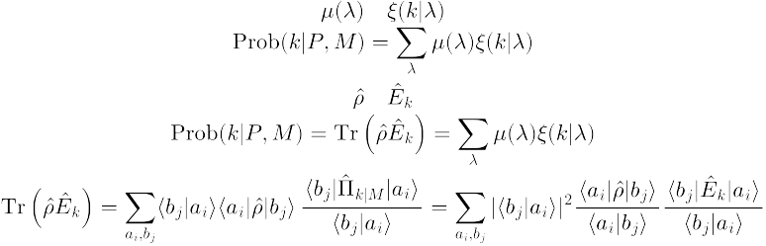
A classical experiment
Probability distribution:
Preparation (P)
Measurement (M)
1
2
3
t
2
3
...
n
System
75%
25%

Slide 20
A classical experiment
Probability distribution:
Preparation (P)
Measurement (M)
Measurement (M)
1
2
3
...
n
25%
75%
System
75%
25%

Slide 21
A classical experiment
Preparation (P)
Measurement (M)
1
2
3
...
n
25%
75%
System
100%

Slide 22
A classical experiment
Response function:
Preparation (P)
Measurement (M)
1
2
3
...
n
25%
75%
System
100%

Slide 23
A classical experiment
Probability distribution:
Response function:
Outcome probabilities:

Slide 24


A quantum experiment
Preparation (P)
Measurement (M)
1
2
3
...
n
System
Set of undefined properties:

Slide 25
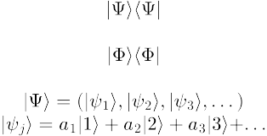
A quantum experiment
Preparation (P)
Measurement (M)
1
2
3
...
n
System
Set of undefined properties:
Superposition:

Slide 26
A quantum experiment
Pure state:
Preparation (P)
Measurement (M)
1
2
3
...
n
System
100%

Slide 27

A quantum experiment
Pure state:
Projective measurement:
Preparation (P)
Measurement (M)
1
2
3
...
n
System
100%

Slide 28

A quantum experiment
Pure state:
Projective measurement:
Preparation (P)
Measurement (M)
1
2
3
...
n
25%
75%
System
100%
Outcome probabilities:

Slide 29
A quantum experiment
Preparation (P)
Measurement (M)
1
2
3
...
n
System
75%
25%

Slide 30

A quantum experiment
Mixed state:
Preparation (P)
Measurement (M)
1
2
3
...
n
System
75%
25%

Slide 31
A quantum experiment
Mixed state:
POVM element:
Preparation (P)
Measurement (M)
1
2
3
...
n
System
75%
25%

Slide 32
A quantum experiment
Mixed state:
POVM element:
Preparation (P)
Measurement (M)
1
2
3
...
n
System
75%
25%
Outcome probabilities:

Slide 33
Is quantum mechanics secretly classical?

Slide 34
Is quantum mechanics classical?
Pure state:
Preparation (P)
Measurement (M)
1
2
3
...
n
25%
75%
System
100%

Slide 35
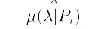
Is quantum mechanics classical?
Probability distribution:
Preparation (P)
Measurement (M)
1
2
3
...
n
25%
75%
System
75%
25%

Slide 36
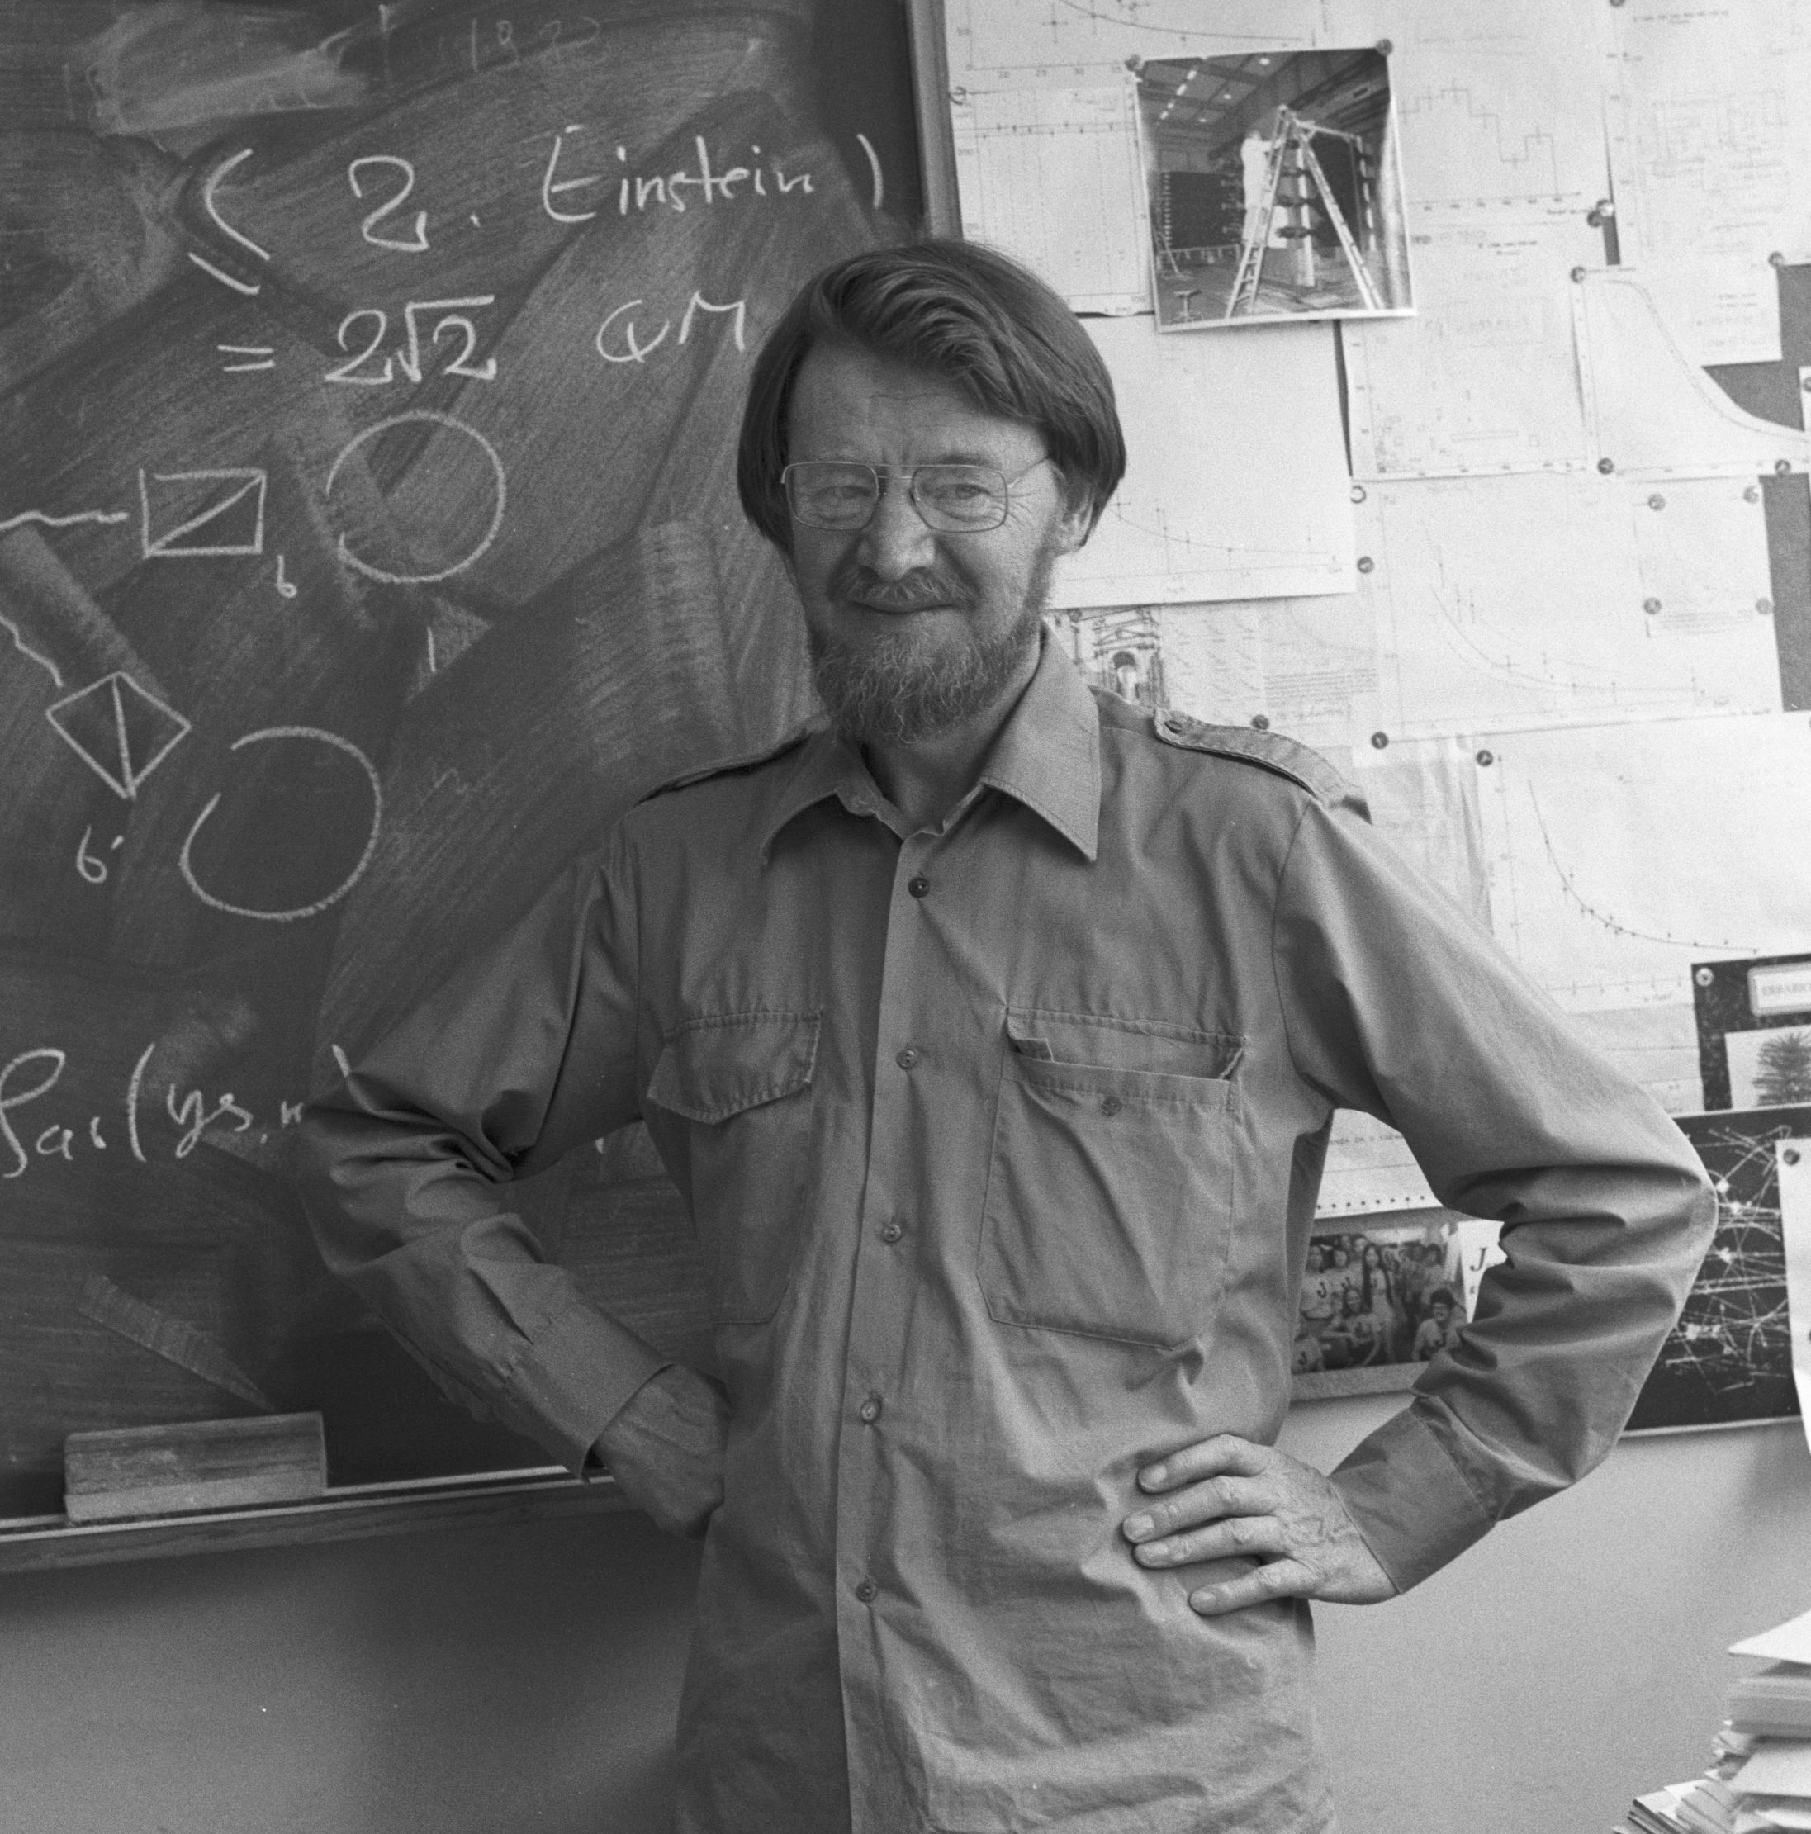
Is quantum mechanics classical?
No :)

Slide 37
Can my experiment be reproduced classically?

Slide 38
Is quantum mechanics classical?
Outcome probabilities:
?

Slide 39
Preparation and Measurement
Preparation (Pi)
Measurement (Mj)
1
2
3
t
1
2
3
...
n
P3
System
M3
P2
...
M2
...
P1
Pr
M1
Mm
Outcome probabilities:

Slide 40
Quasiprobability representations and weak values

Slide 41

Quasiprobability representations
Quasiprobability representations:

Slide 42
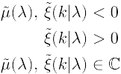
Quasiprobability representations
Quasiprobability representations:
Anomalous features:

Slide 43
Quasiprobability representations
Quasiprobability representations:
Anomalous features:
Ferrie, Christopher. "Quasi-probability representations of quantum theory with applications to quantum information science." Reports on Progress in Physics 74.11 (2011): 116001.
Spekkens, Robert W. "Negativity and contextuality are equivalent notions of nonclassicality." Physical review letters 101.2 (2008): 020401.

Slide 44
Quasiprobability representations
Quasiprobability representations:
Quasiprobability
distribution
Anomalous features:
Ferrie, Christopher. "Quasi-probability representations of quantum theory with applications to quantum information science." Reports on Progress in Physics 74.11 (2011): 116001.
Spekkens, Robert W. "Negativity and contextuality are equivalent notions of nonclassicality." Physical review letters 101.2 (2008): 020401.

Slide 45
Quasiprobability representations
Quasiprobability representations:
Quasiprobability
distribution
Symbol
Anomalous features:
Ferrie, Christopher. "Quasi-probability representations of quantum theory with applications to quantum information science." Reports on Progress in Physics 74.11 (2011): 116001.
Spekkens, Robert W. "Negativity and contextuality are equivalent notions of nonclassicality." Physical review letters 101.2 (2008): 020401.

Slide 46
Quasiprobability representations
Kirkwood-Dirac quasiprobability representation:
Two orthonormal basis:

Slide 47
Quasiprobability representations
Kirkwood-Dirac quasiprobability representation:
Two orthonormal basis:

Slide 48
Quasiprobability representations
Kirkwood-Dirac quasiprobability representation:
Two orthonormal basis:

Slide 49
Quasiprobability representations
Two orthonormal basis:
Kirkwood-Dirac quasiprobability representation:

Slide 50
Quasiprobability representations
Two orthonormal basis:
Kirkwood-Dirac quasiprobability representation:

Slide 51
Quasiprobability representations
Two orthonormal basis:
Kirkwood-Dirac quasiprobability representation:
Weak value

Slide 52
Quasiprobability representations
Two orthonormal basis:
Kirkwood-Dirac quasiprobability representation:
Weak value
..and we can measure it!

Slide 53
Quasiprobability representations
Two orthonormal basis:
Kirkwood-Dirac quasiprobability representation:
Weak values!
..and we can measure them!

Slide 54

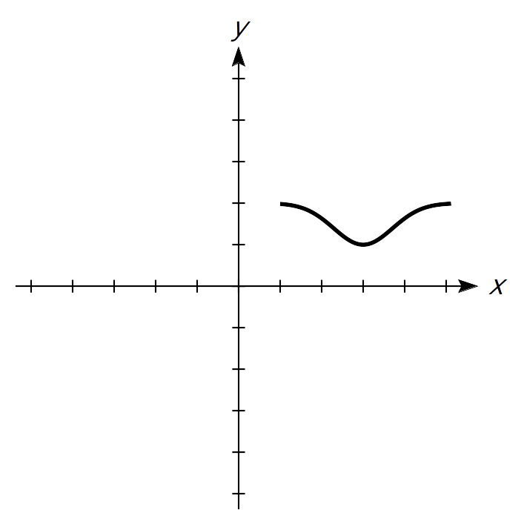
A standard (Von Neumann) measurement
Stern-Gerlach
Spin
Position

Slide 55
A standard (Von Neumann) measurement
Stern-Gerlach
∆t
Spin
Position
N
S

Slide 56
A standard (Von Neumann) measurement
Stern-Gerlach
∆t
Spin
Position
N
Interaction strength
S

Slide 57
A weak measurement
Spin
Position
Aharonov, Yakir, et al. "How the result of a measurement of a component of the spin of a spin-1/2 particle can turn out to be 100." Physical review letters 60.14 (1988): 1351.

Slide 58
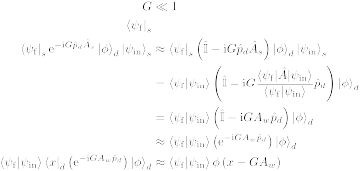
A weak measurement
Weak interaction
Spin
Position
N
S
Aharonov, Yakir, et al. "How the result of a measurement of a component of the spin of a spin-1/2 particle can turn out to be 100." Physical review letters 60.14 (1988): 1351.

Slide 59
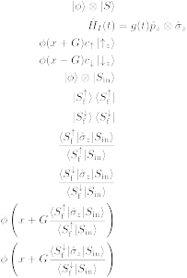
A weak measurement
Weak interaction
Spin
Position
N
Post-selection
N
S
S
Aharonov, Yakir, et al. "How the result of a measurement of a component of the spin of a spin-1/2 particle can turn out to be 100." Physical review letters 60.14 (1988): 1351.

Slide 60
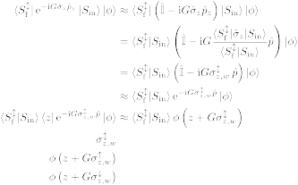

A weak measurement
Weak interaction
Spin
Position
N
Post-selection
N
S
S
Spin weak value:
Aharonov, Yakir, et al. "How the result of a measurement of a component of the spin of a spin-1/2 particle can turn out to be 100." Physical review letters 60.14 (1988): 1351.

Slide 61
Weak values extraction in neutron interferometry
Meter state and weak interaction:
Lemmel, Hartmut, et al. "Quantifying the presence of a neutron in the paths of an interferometer." Physical Review Research 4.2 (2022): 023075.
Danner, Armin, et al. "Simultaneous path weak-measurements in neutron interferometry." Scientific Reports 14.1 (2024): 25994.
Dvorak, Andreas, et al. "Tight qubit uncertainty relations studied through weak values in neutron interferometry." Physical Review Research 7.4 (2025): 043334.
Meter state and no weak interaction:
Denkmayr, Tobias, et al. "Weak values from strong interactions in neutron interferometry." Physica B: Condensed Matter 551 (2018): 339-346.
No meter state and weak interaction:
Masiello, Ismaele V., et al. "Simultaneous determination of two path weak-values with time-dependent phase manipulation in neutron interferometry." New Journal of Physics 27.2 (2025): 023017.

Slide 62
Weak values extraction in neutron interferometry
Meter state and weak interaction:
Lemmel, Hartmut, et al. "Quantifying the presence of a neutron in the paths of an interferometer." Physical Review Research 4.2 (2022): 023075.
Danner, Armin, et al. "Simultaneous path weak-measurements in neutron interferometry." Scientific Reports 14.1 (2024): 25994.
Dvorak, Andreas, et al. "Tight qubit uncertainty relations studied through weak values in neutron interferometry." Physical Review Research 7.4 (2025): 043334.
Meter state and no weak interaction:
Denkmayr, Tobias, et al. "Weak values from strong interactions in neutron interferometry." Physica B: Condensed Matter 551 (2018): 339-346.
No meter state and weak interaction:
Masiello, Ismaele V., et al. "Simultaneous determination of two path weak-values with time-dependent phase manipulation in neutron interferometry." New Journal of Physics 27.2 (2025): 023017.

Slide 63
Weak values extraction in neutron interferometry
Meter states or weak interactions increase
the experimental complexity!
The manipulation of additional degrees of freedom increases the amount of required experimental resources (additional instrumentation and procedures), while weak interactions typically necessitate longer measurement times due to the limited information gained per detection event.

Slide 64
Weak values extraction in neutron interferometry
Meter states or weak interactions increase
the experimental complexity!
The manipulation of additional degrees of freedom increases the amount of required experimental resources (additional instrumentation and procedures), while weak interactions typically necessitate longer measurement times due to the limited information gained per detection event.
No meter state and no weak interaction:
Masiello, Ismaele V., et al. "Anomalous weak values in a generalized Mach-Zehnder interferometer extracted directly from intensity measurements." arXiv:2606.24798v1 - in review at npj Quantum Information.

Slide 65
Experimental results

Slide 66

Neutron interferometry
Neutron Mach-Zehnder interferometer:

Slide 67




Neutron interferometry
Generalized neutron
Mach-Zehnder interferometer:
Neutron

Slide 68
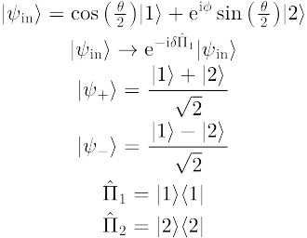
Weak values from output intensities
Initial state:
Generalized neutron
Mach-Zehnder interferometer:
Path observable:
2
1

Slide 69
Weak values from output intensities
Initial state:
Generalized neutron
Mach-Zehnder interferometer:
Path observable:
Phase shift:

Slide 70
Weak values from output intensities
Initial state:
Generalized neutron
Mach-Zehnder interferometer:
Path observable:
Phase shift:
-
+
Final states:

Slide 71
Weak values from output intensities
Initial state:
Generalized neutron
Mach-Zehnder interferometer:
Path observable:
Phase shift:
Final states:
Measured intensity:

Slide 72
Weak values from output intensities
Initial state:
Generalized neutron
Mach-Zehnder interferometer:
Path observable:
Phase shift:
Final states:
Measured intensity:

Slide 73
Neutron interferometry
Why neutron interferometry?
Interference is intrinsically a single-massive-particle phenomenon.
Matter-wave interferometry at room temperature and ambient pressure, with macroscopic beam separation and high contrast.
Manipulation of several degrees of freedom (path, spin, energy).
Sponar, S., Sedmik, R. I., Pitschmann, M., Abele, H. & Hasegawa, Y. Tests of fundamental quantum mechanics and dark interactions with low-energy neutrons. Nat. Rev. Phys. 3, 309–327 (2021).

Slide 74

Weak values from output intensities
Generalized neutron
Mach-Zehnder interferometer:
Weak values can be
directly extracted from
the output intensities!
Path weak-values:

Slide 75
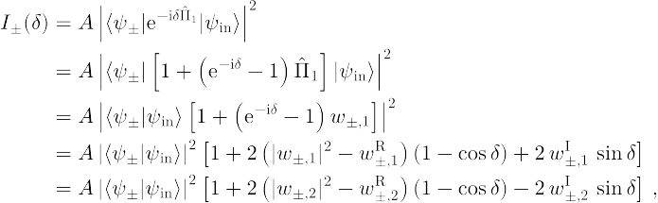
Weak values from output intensities
Measured intensity:
Amplitude
squared
Real
part
Imaginary
part

Slide 76
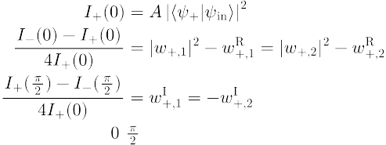

Weak values from output intensities
Three measurements settings:

Slide 77
Weak values from output intensities
Three measurements settings:

Slide 78
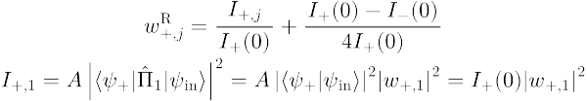
Weak values from output intensities
Three measurements settings:

Slide 79
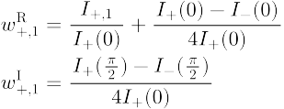
Weak values from output intensities
Weak value extraction:

Slide 80
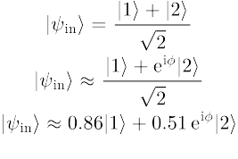
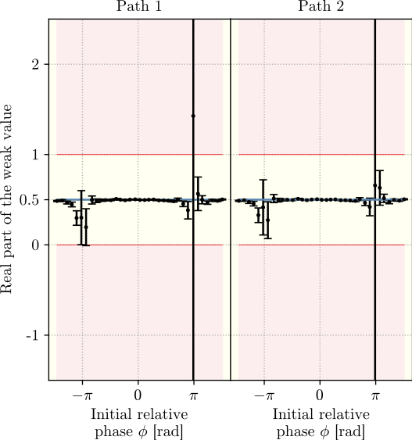
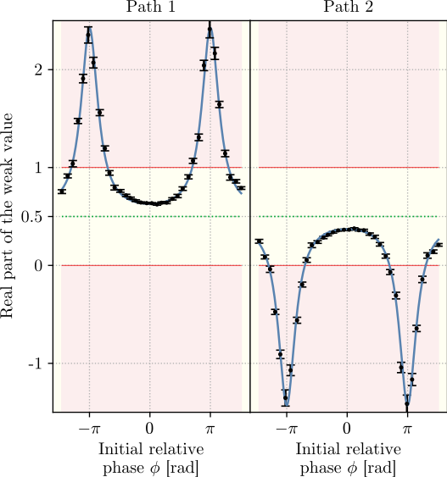
Weak values from output intensities
Balanced:
Unbalanced:

Slide 81
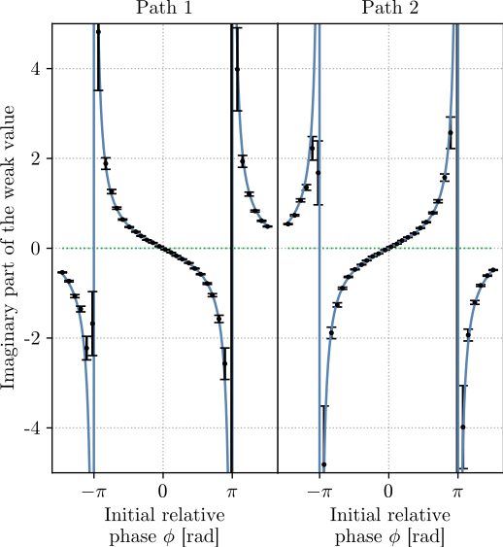
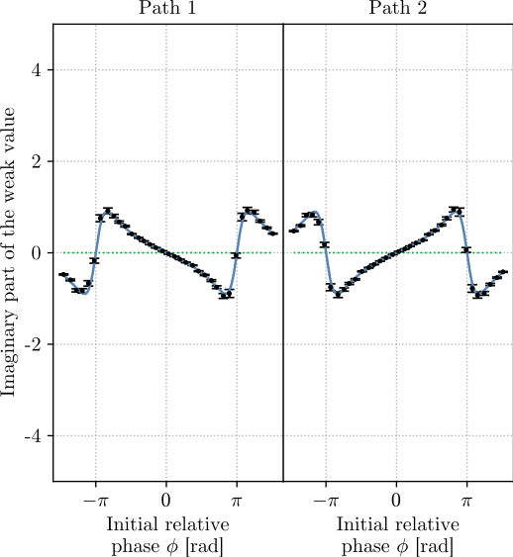
Weak values from output intensities
Balanced:
Unbalanced:

Slide 82
Weak values from output intensities
Blocker
Required setup:
Interferometer
Path blocker
Phase shifter
Measurements:
No meter state and no weak interaction (shorter acquisition times with comparable or improved precision)
3 measurements needed to completely determine the path weak-values

Slide 83
Weak values from output intensities
Bonus experimental result!
Three-path neutron interferometer:
3
2
1

Slide 84

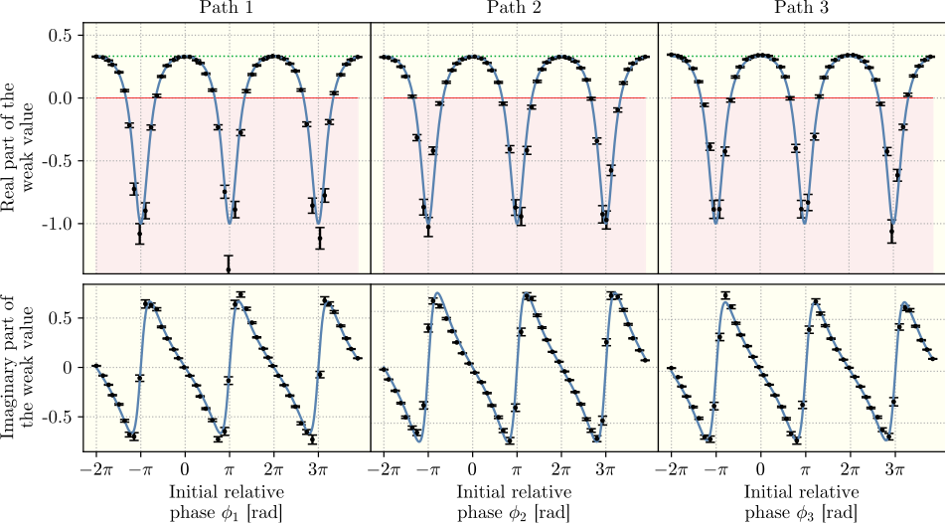
Weak values from output intensities
Initial state:

Slide 85
Summary
Quantum mechanics is nonclassical, but not always
Weak values can be used to identify nonclassical phenomena
Our group developed several methods to extract weak values in neutron interferometry
In particular, one method that requires no weak interaction and no meter state was presented. The method can be applied any N-level quantum system in which alike measurements can be performed.

Slide 86
Neutron Interferometry Group
Yuji Hasegawa (Professor/supervisor)
Stephan Sponar (Professor)
Hartmut Lemmel (Instrument responsible)
Andreas Dvorak (PhD student)
Florian Engel (PhD student)
Kazuma Obigane (PhD student)

Slide 87
Thank you for your attention!

